Slide 1

Micro-blog of Chinese poem
Group 4

Slide 2

overview
A social networking tool
Allow you to share your literate poem
Make people’s voice stranger

Slide 3
Appearance
Comfortable & Convenient
generous & simple
Elegant

Slide 4
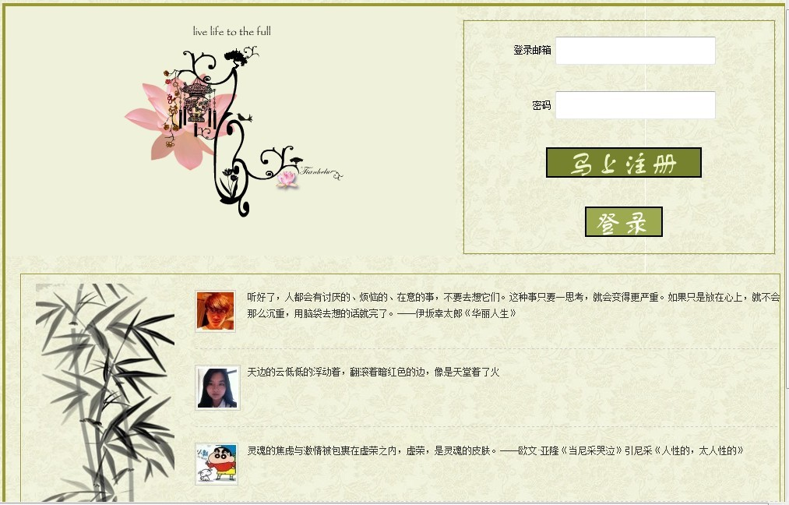

Slide 5
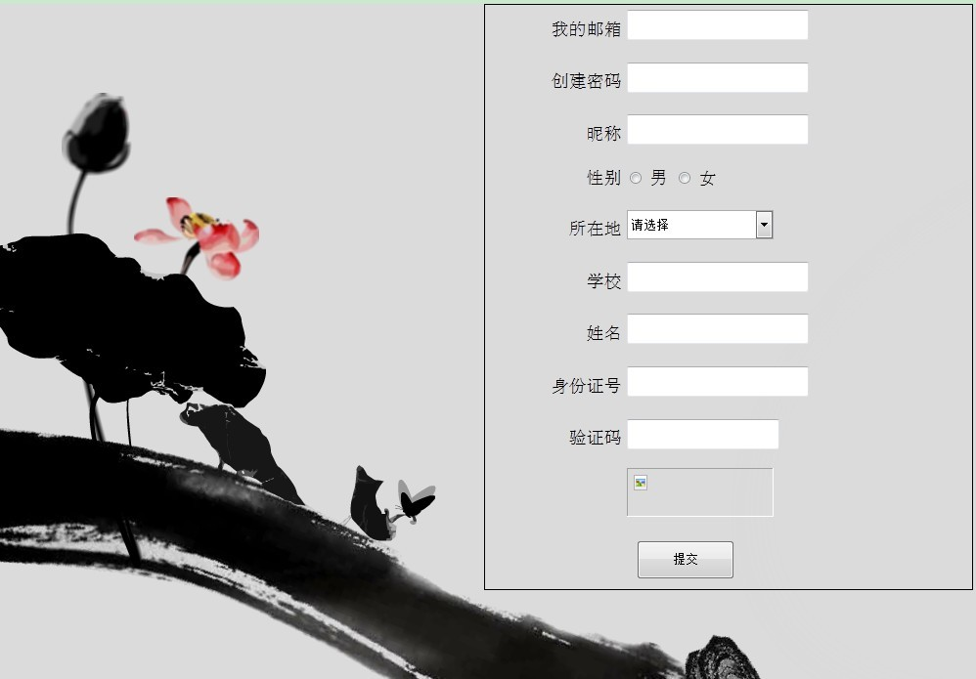

Slide 6
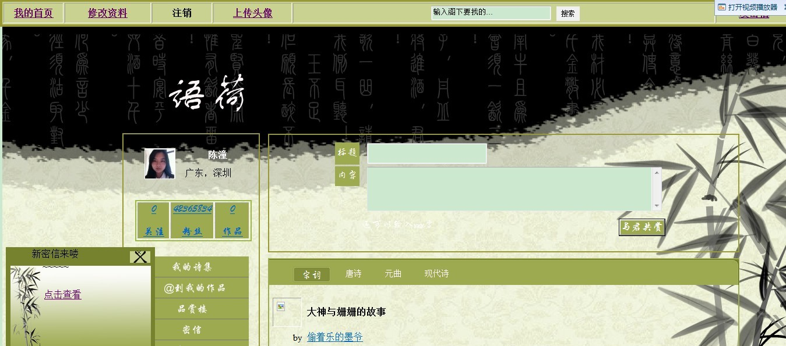
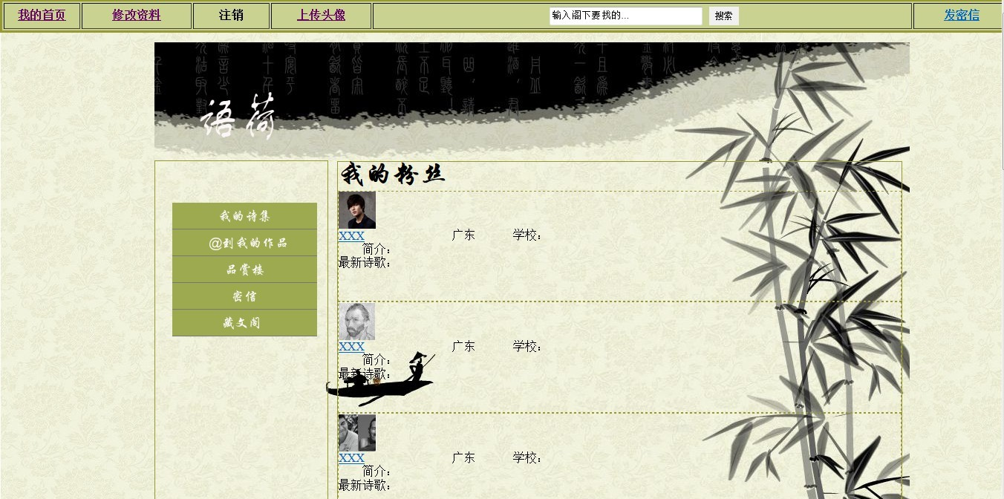

Slide 7
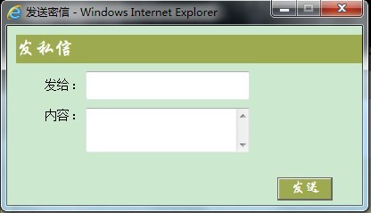

Slide 14
features
Update and share
Comment
Message box
Collect
Make Friends

Slide 15
Technology
JQuery
JavaBean
JSP
SQL
Java
CSS
Flash & Photoshop

Slide 16
Thanks for your listening

